Slide 1

C4AI Presentation
By Rahman, Jaryl, Kiat Boon, Yan Ruey

Slide 2
Tables of Contents:
Introduction
What to expect from our presentation?
What our pipeline looks like?
Results of our Pipeline
Modeling results
Evaluation results
Comparison
Summary
Who did what?
End

Slide 3
What to expect from this presentation?
Problems and Explanation
Diagram of our pipeline
Modelling data results
Evaluation data results

Slide 4
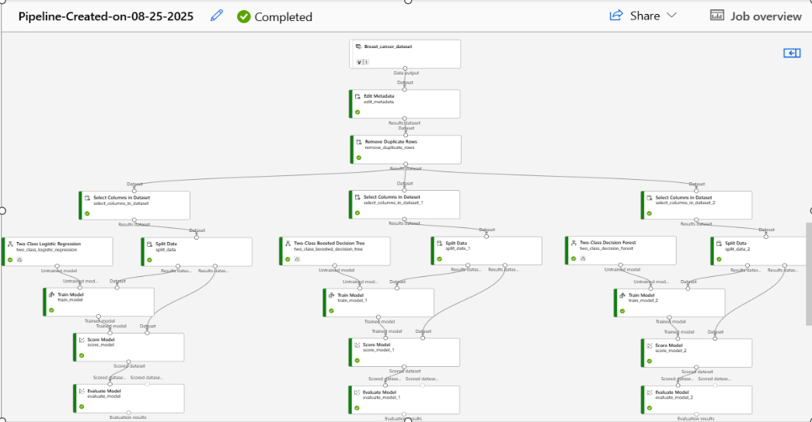
What our pipeline looks like?
Edit Metadata: All columns
Remove Duplicate: All columns
SC1: Diagnosis,id
SC2: Diagnosis, id, radius, mean
SC3: Diagnosis, id, radius, mean, texture_mean,
perimeter_mean
TM: Diagnosis

Slide 5

Use the Edit Metadata component to change metadata that's associated with columns in a dataset. The value and data type of the dataset will change after use of the Edit Metadata component. It is to prevent any error in the data and modify the columns in the dataset.

Slide 6

Identifies duplicate rows based on selected key columns.
Removes repeated entries, keeping only one unique instance.
Creates a new dataset with duplicates filtered out (original data remains unchanged).

Slide 7

Use this component to choose a subset of columns to use in downstream operations. The component does not physically remove the columns from the source dataset; instead, it creates a subset of columns, much like a database view or projection.
This component is useful when you need to limit the columns available for a downstream operation, or if you want to reduce the size of the dataset by removing unneeded columns.

Slide 8

For the 1st set
Creates a two-class logistic regression model. Logistic regression is a well-known method in statistics that is used to predict the probability of an outcome and is especially popular for classification tasks. The algorithm predicts the probability of occurrence of an event by fitting data to a logistic function.

Slide 9

For the 2nd set
Use this component to create a machine learning model that is based on the boosted decision trees algorithm.
A boosted decision tree is an ensemble learning method in which the second tree corrects for the errors of the first tree, the third tree corrects for the errors of the first and second trees, and so forth. Predictions are based on the entire ensemble of trees together that makes the prediction.
Generally, when properly configured, boosted decision trees are the easiest methods with which to get top performance on a wide variety of machine learning tasks. However, they are also one of the more memory-intensive learners, and the current implementation holds everything in memory. Therefore, a boosted decision tree model might not be able to process the large datasets that some linear learners can handle.

Slide 10
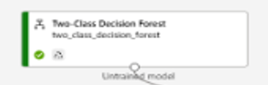
For the 3rd set
Use this component to create a machine learning model based on the decision forests algorithm.
Decision forests are fast, supervised ensemble models. This component is a good choice if you want to predict a target with a maximum of two outcomes.

Slide 11

Use this component to train a classification or regression model. Training takes place after you have defined a model and set its parameters, and requires tagged data. You can also use Train Model to retrain an existing model with new data.

Slide 12

Evaluating performance using metrics like accuracy, precision, recall
Applying a trained model to new, unseen data
Generating predictions (e.g., classification labels, regression values)

Slide 13

The Evaluate Model component calculates industry-standard metrics based on the type of model you're working with:
Classification models: Metrics like accuracy, precision, recall, F1 score, and AUC.
Regression models: Metrics such as mean absolute error, root mean squared error, and R² score.
Clustering models: Measures like average distance to cluster centers and assignment accuracy.

Slide 14
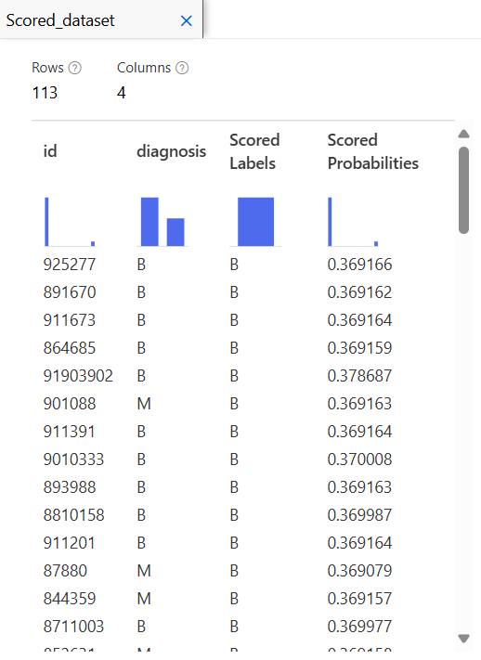
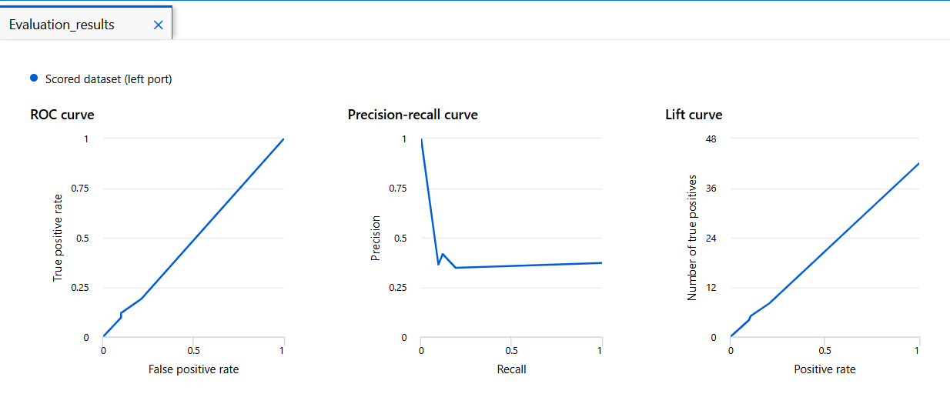
Leftmost most accurate dataset
80% trained 20% testing

Slide 15
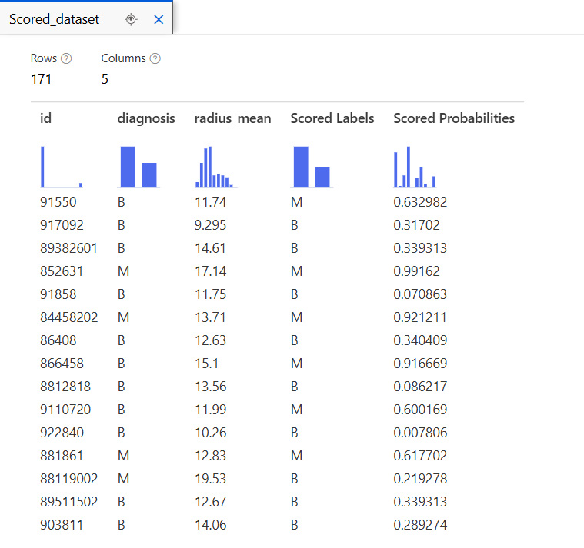
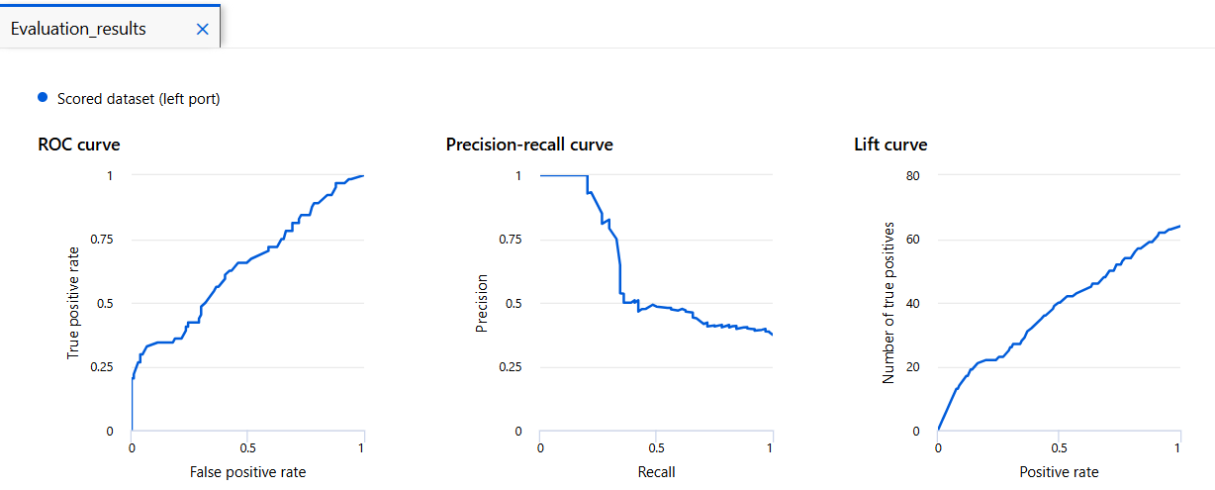
Middle medium accurate dataset
70% trained 30% testing

Slide 16
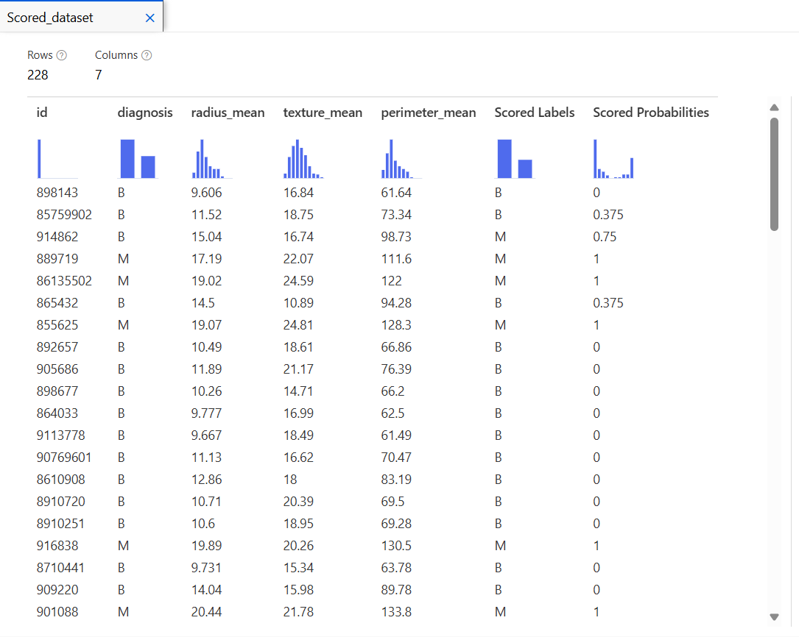
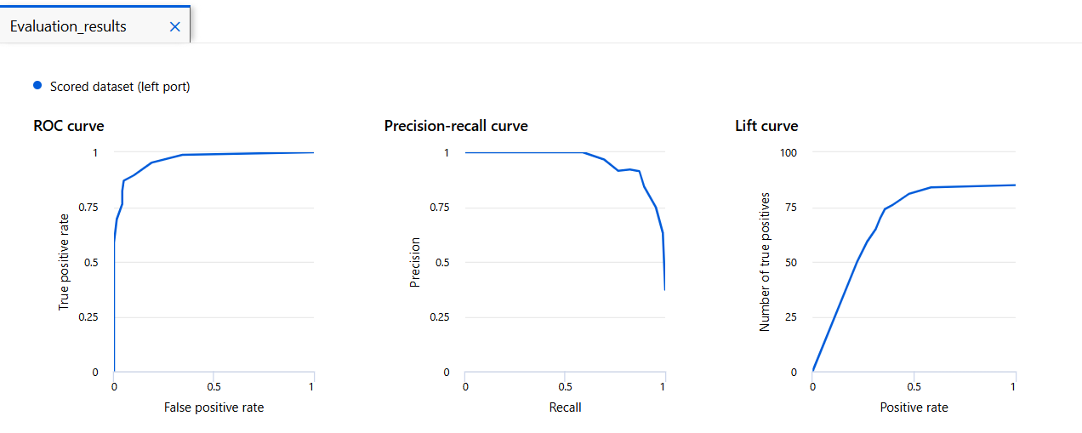
Rightmost least accurate dataset
60% trained 40% testing

Slide 17
Explanation
Explain the rationale behind how training and test datasets are divided.
  Its about ensuring generalization and fair evaluation.
  Unbiased Evaluation: The test set acts like a proxy for future data. It must be untouched during training to give a realistic measure of performance.
  Avoid Data Leakage: If information from the test set sneaks into training, it contaminates the evaluation. This is especially critical in medical diagnostics where false confidence can have serious consequences
  Representative Sampling: Both sets should reflect the same distribution (e.g., similar proportions of benign vs malignant cases) to avoid skewed results.
Explain your findings from the prediction.
  False Negatives (malignant predicted as benign) are present. These are the most dangerous errors in this context.
  Probability clustering around 0.369 might suggest the model isn’t well-calibrated or is overconfident in certain regions.
  Model performance is promising, but further tuning (e.g. threshold adjustment, calibration, or cost-sensitive learning) could reduce critical errors.
Explain your findings from the model's performance.
Scored dataset most predictions for benign cases are correctly labeled as benign with probabilities around 0.369.
The ROC curve rises steeply from the origin, which is a good sign, it means the model has a high true positive rate and a low false positive rate across thresholds
The Precision Recall curve starts with high precision but drops sharply as recall increases.
The Lift curve shows that the model performs better than random guessing, especially in the early percentiles.

Slide 18
Summary
We have shown you the:
Pipeline
Evaluation
The most accurate results of the pipeline
The medium accurate results of the pipeline
The least accurate results of the pipeline

Slide 19
Who did what?
Rahman: Slides / Explanation of each pipeline module
Kiat Boon: Pipeline / Screenshots of the pipeline / Explanation
Jaryl: Slides
Yan Ruey: Slides

Slide 20
Thank you for listening!!
We hope you enjoy learning and gain experience on this presentation. We sincerely appreciate your attention!!

